Slide 1

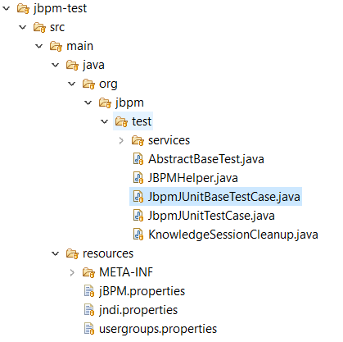
Testing and Debugging
Notes:
Working with the jBPM console

Slide 2
Agenda
01
02
03
Unit Testing
Debugging
Quiz
04
Conclusion

Slide 3
Unit Testing

Slide 4
Debugging

Slide 5

Quiz
Testing and Debugging

Slide 6
Quiz
Unit Testing would be done by ________
Designer
Tester
Developer
Customer

Slide 7

Answers
Unit Testing would be done by ________
Designer
Tester
Developer
Customer

Slide 8
Quiz
Debugging is not important in jBPM Projects
True
False

Slide 9
Answers
Debugging is not important in jBPM Projects
True
False

Slide 10
Conclusion

Slide 11


Summary
In this session, you have learnt:
Unit Testing
Debugging

Slide 12

India : +91-7847955955
US : 1-800-216-8930 (TOLL FREE)
support@intellipaat.com
24X7 Chat with our Course Advisor
Notes:
Thank you!

